Slide 1
“Telecom Customer Churn case study “

Slide 2
Mentor Name :-
Mr. Saurabh Singh
Team Members :-
Mr. Kapil Mane Deshmukh
Mr. Kamlesh Patil
Miss. Sahana Rao
Miss. Sneha Chogale
Mr. Ashutosh Adsule
Mr. Satish Kumar
Mr. Pavan Kumar

Slide 3
Problem Statement
A telecom company is losing users to competitors. They want an ML Model to determine which of their current customers may churn based on the historical customer churn data that they have.

Slide 4
Technical Parameters
Software
Python
Libraries
Pandas
Models
Seaborn
Scikitlearn
Numpy
Linear Regression
Random Forest
Deployment
Streamlit
Decision Tree
Logistic Regression
Adaboost
Spyder
Imblearb

Slide 5
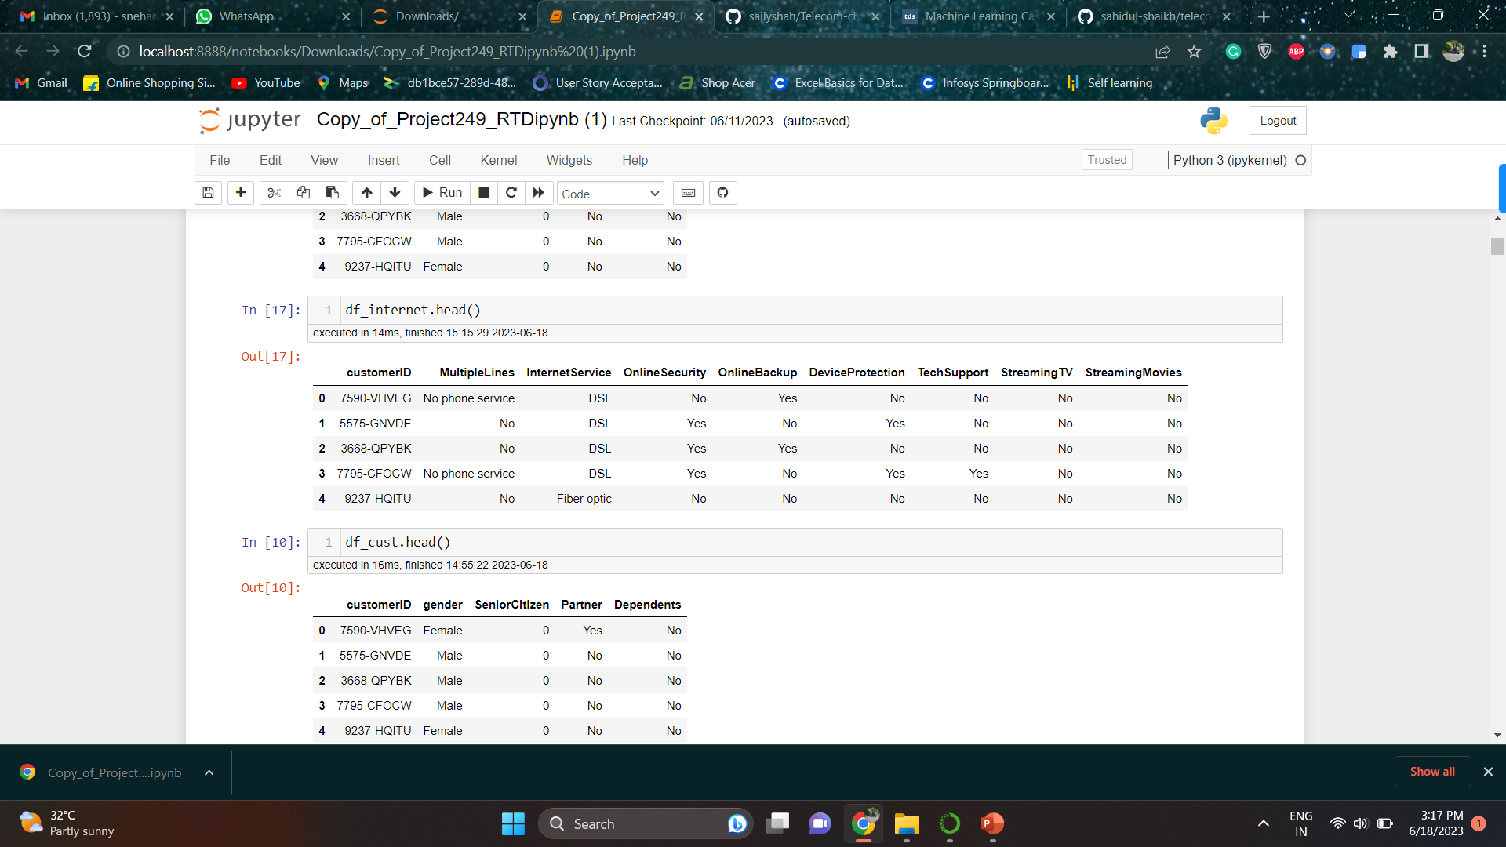
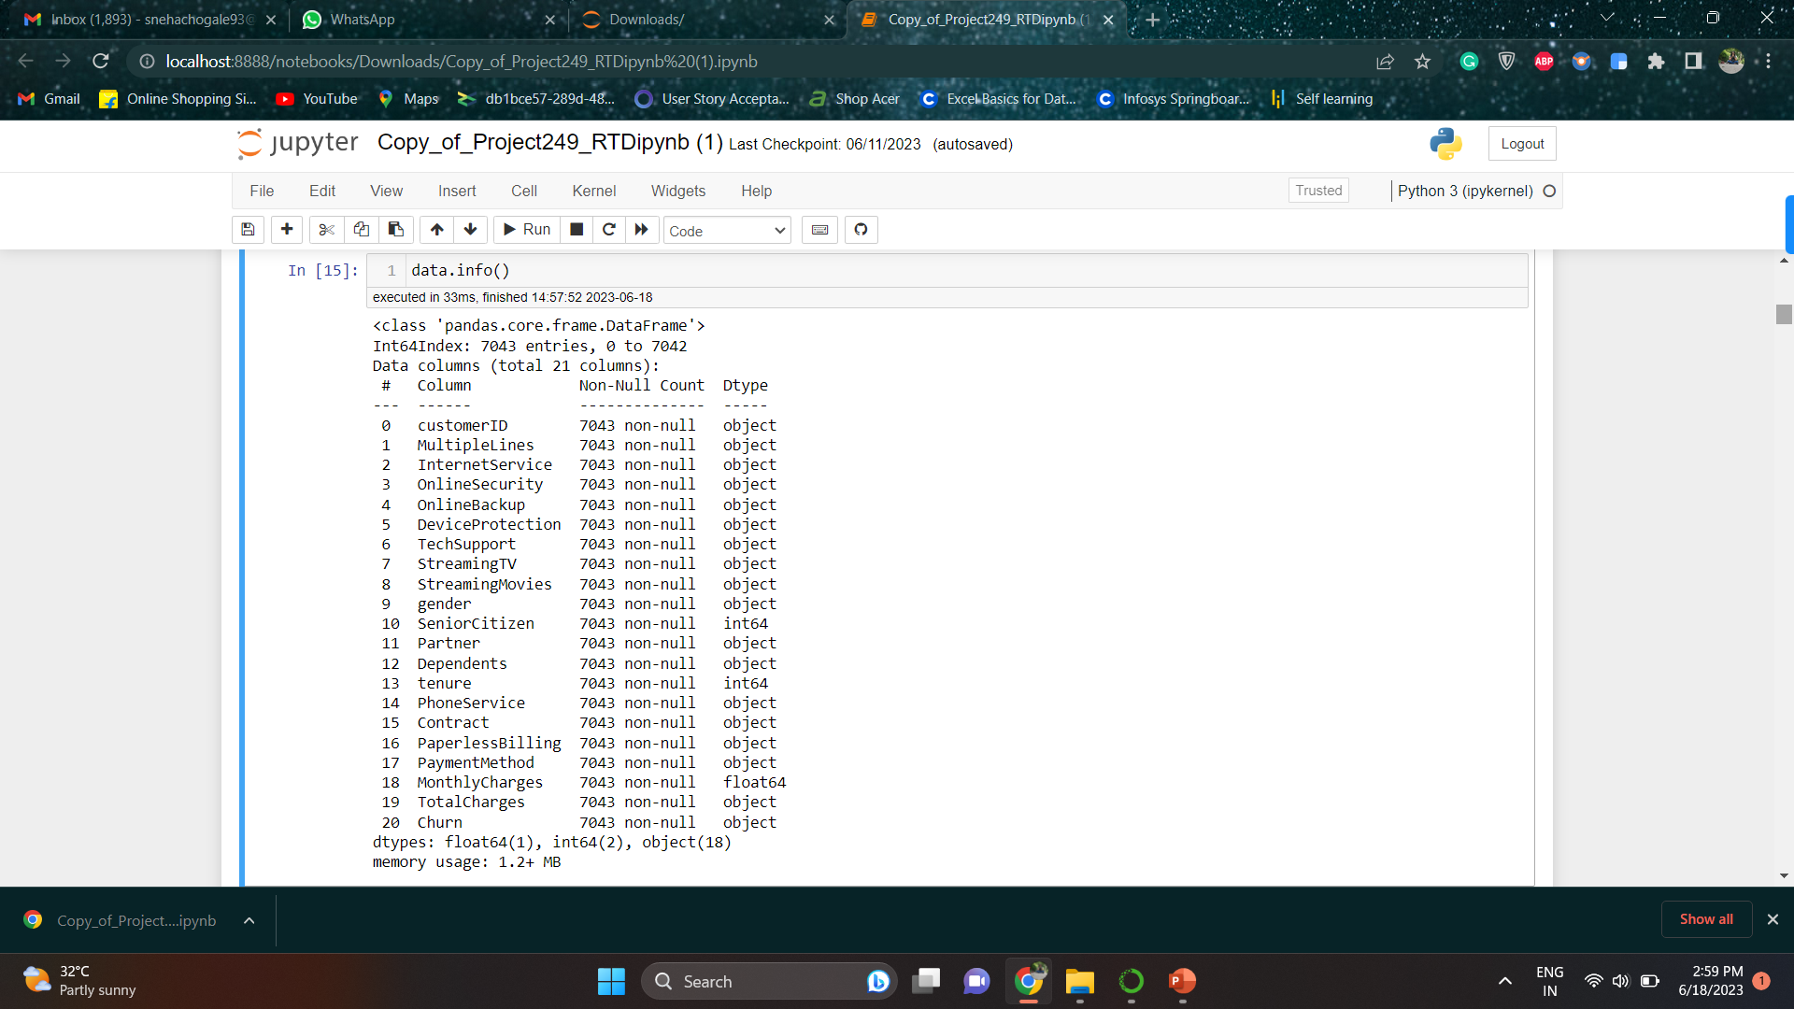
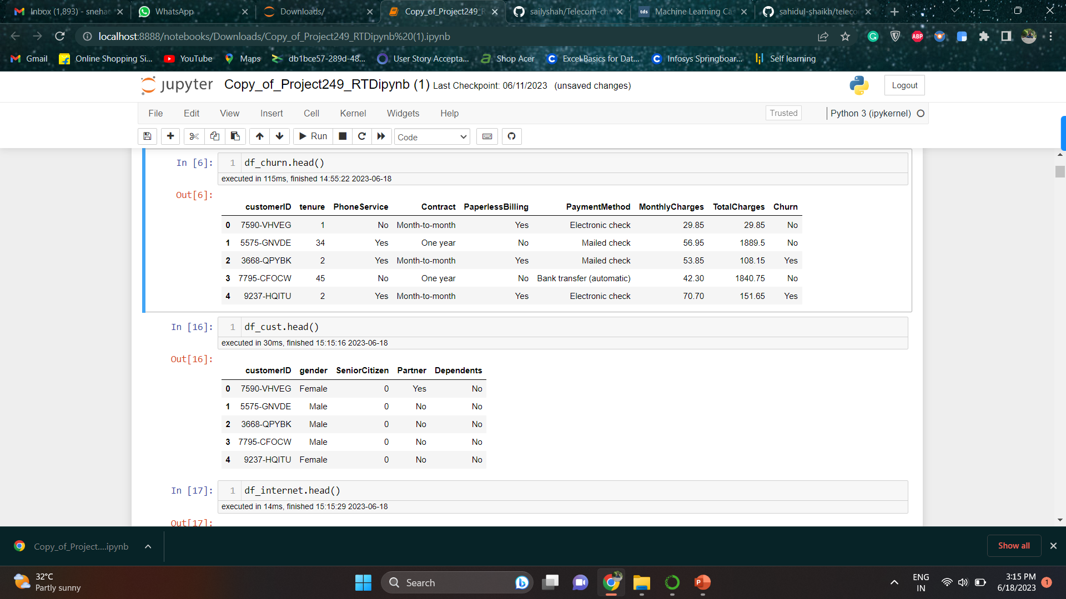
Dataset Details
After combine three datasets, We have 7043 records and 21 features in the main datasets.
There are no any null value in the datasets but there is one feature having wrong data type. After correcting the data type we found there is null value present in data.

Slide 6
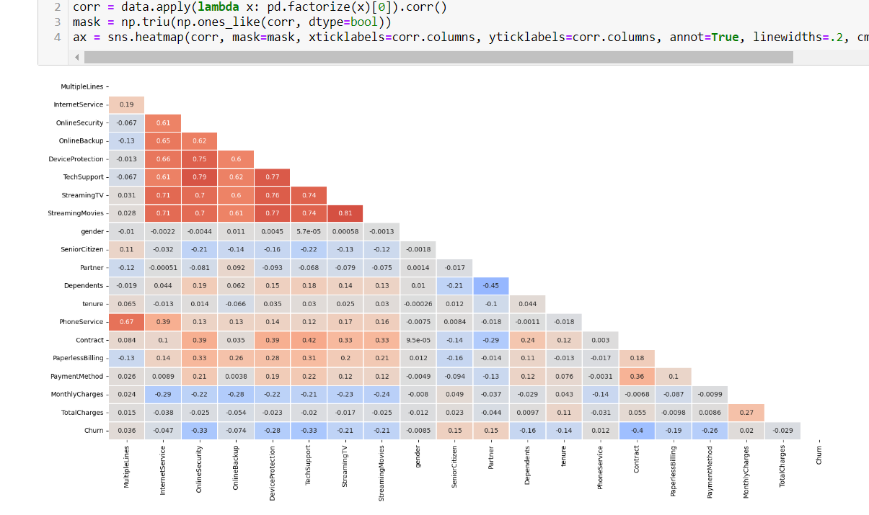
EDA
Dropped null values from Total Charges features as there are only 11 null values are present.
Dropped some unnecessary feature like customerID
There are some features having values likes yes, no, no service so we converted into yes and no.

Slide 7
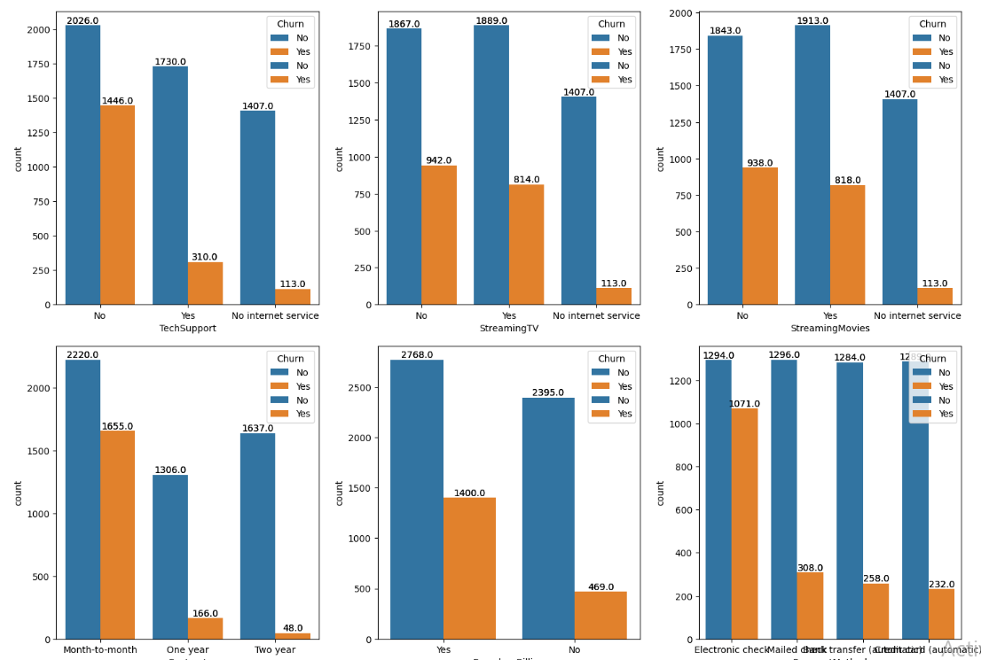
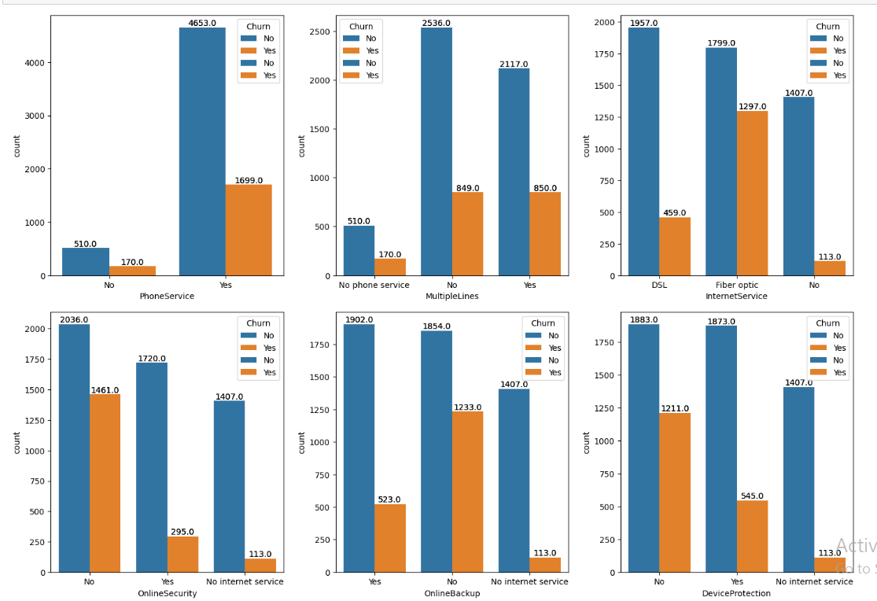
Data Visualization
No online security churning rate is High - 71.3 %
No online backup Churning rate is High - 66 %
No device protection churning rate is High -64 %
No Tech Support Churning rate is 71%
Month to Month contract Churning rate is High about 75 %
Electronic Check customer churning rate is High about 82 %

Slide 8
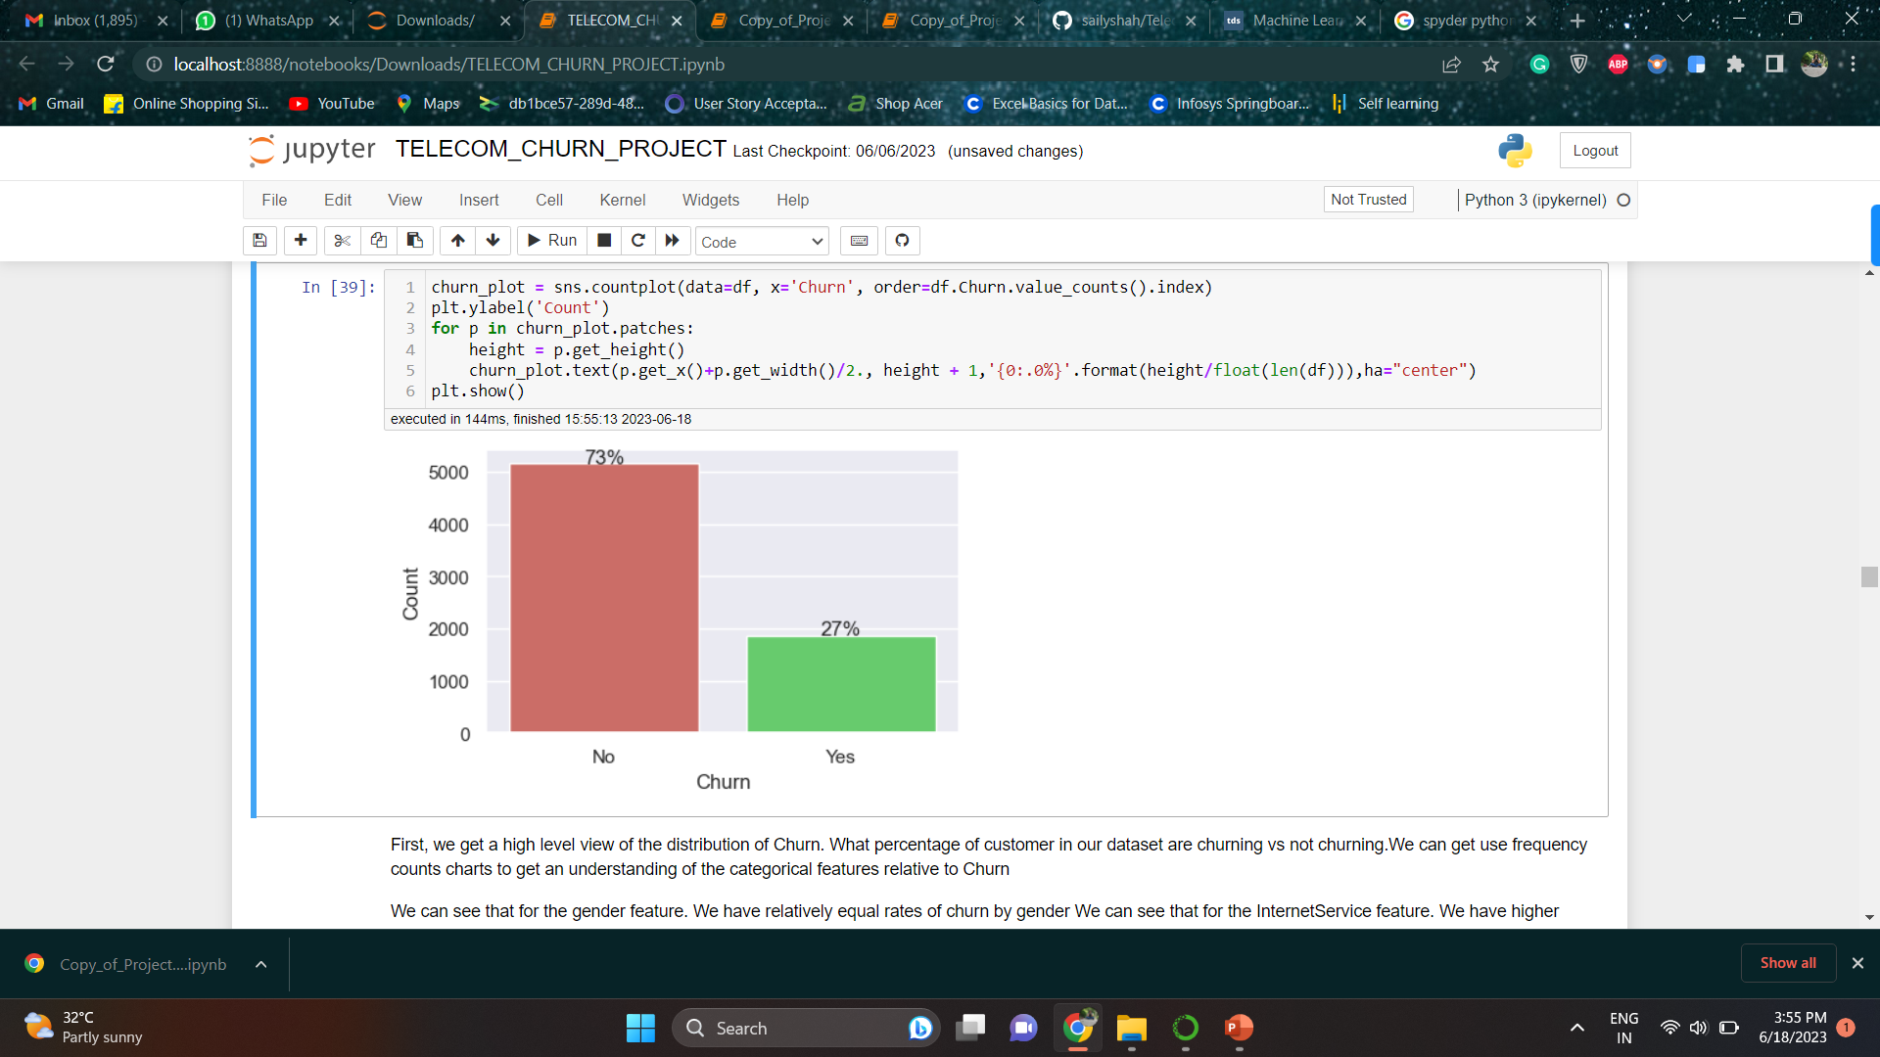
Imbanced Data
The plot shows a class imbalance of the data between churners and non-churners.
Churning customers have much lower tenure with a median of ca. 10 months compared to a median of non-churners of ca. 38 months.

Slide 9
Feature Selection
we can conclude that gender and phone service features has p_value >0.05, hence gender and phone service does not have much significance on target variable.
So we will need to exclude gender and phone service selection for further machine learning modeling. We will be exclude after customer confirmation .
This technique is based on hypothesis it might be possible some data is important but chi-squared test is not showing that much significance in such scenario our domain knowledge play a pivotal role

Slide 10
MODEL Building
Algorithm selection is a key challenge in any machine learning project since there is not an algorithm that is the best across all projects. Generally, we need to evaluate a set of potential candidates and select for further evaluation those that provide better performance.
In this project, we compare 8 different algorithms, all of them already implemented in Scikit-Learn. Also SMOTE technique is used for over and under sampling.
K Nearest Neighbors
Logistic Regression
Support Vector Machines
Random Forest
Gradient Boosting
Decision Tree Classifier
Random Forest classifier
Ada Boost Classifier

Slide 11
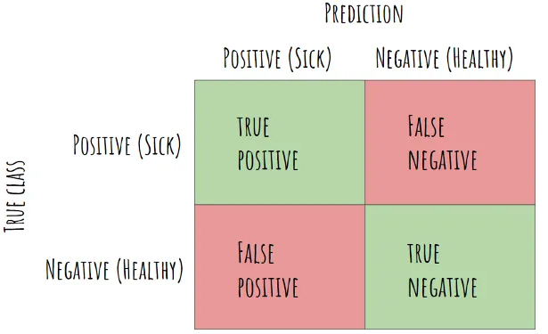
Hyperparameter tuning, confusion matrix
Thus far we have split our data into a training set for learning the parameters of the model, and a testing set for evaluating its performance. The next step in the machine learning process is to perform hyperparameter tuning. The selection of hyperparameters consists of testing the performance of the model against different combinations of hyperparameters, selecting those that perform best according to a chosen metric and a validation method.
The last step of the machine learning process is to check the performance of the model (best hyperparameters ) by using the confusion matrix and some evaluation metrics.
Confusion matrix
The confusion matrix, also known as the error matrix, is used to evaluate the performance of a machine learning model by examining the number of observations that are correctly and incorrectly classified. Each column of the matrix contains the predicted classes while each row represents the actual classes or vice versa. In a perfect classification, the confusion matrix will be all zeros except for the diagonal. All the elements out of the main diagonal represent misclassifications. There is trade off between False positive and false negative value ( Precision and recall ) which need to be taken in consideration with customer. Finally F1 score is harmonic mean of precision and the recall value which will apply penalty to lower precision or recall

Slide 12
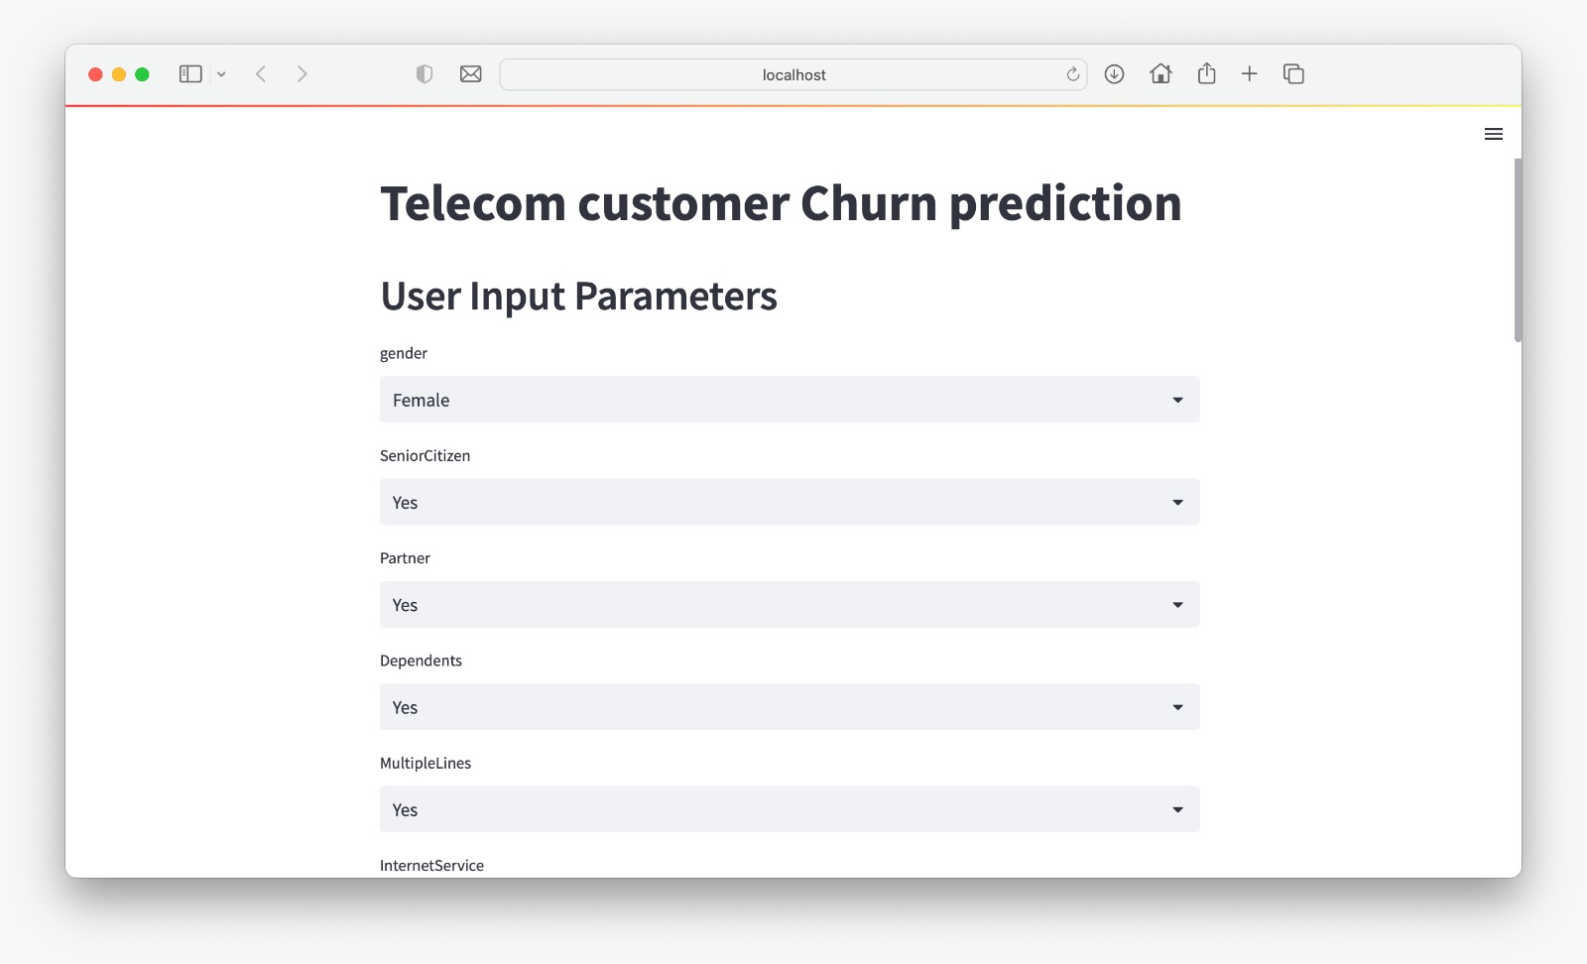
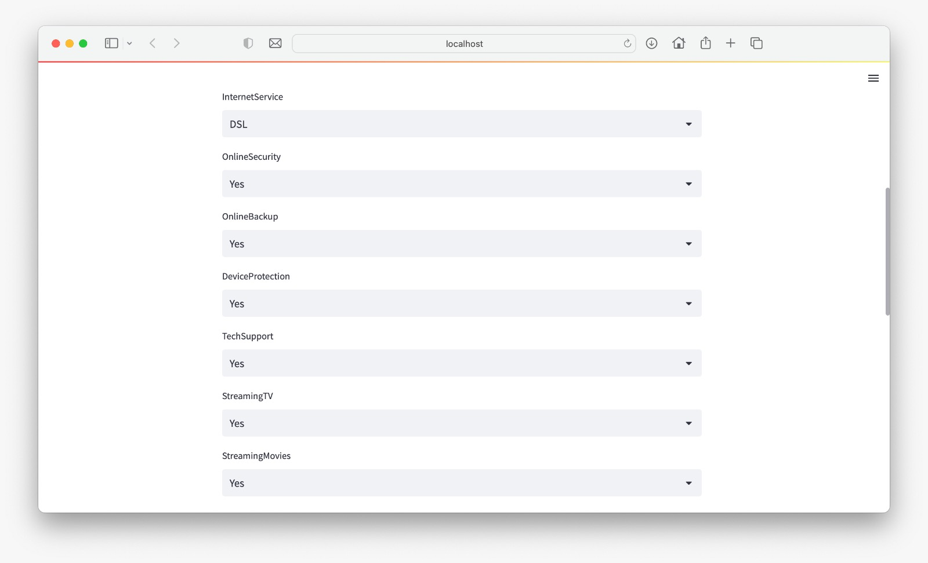
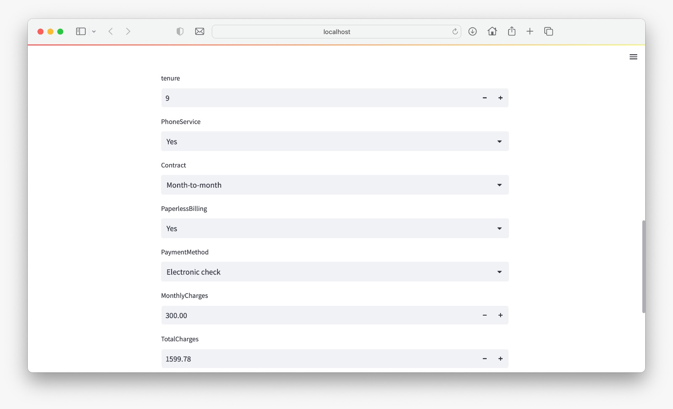
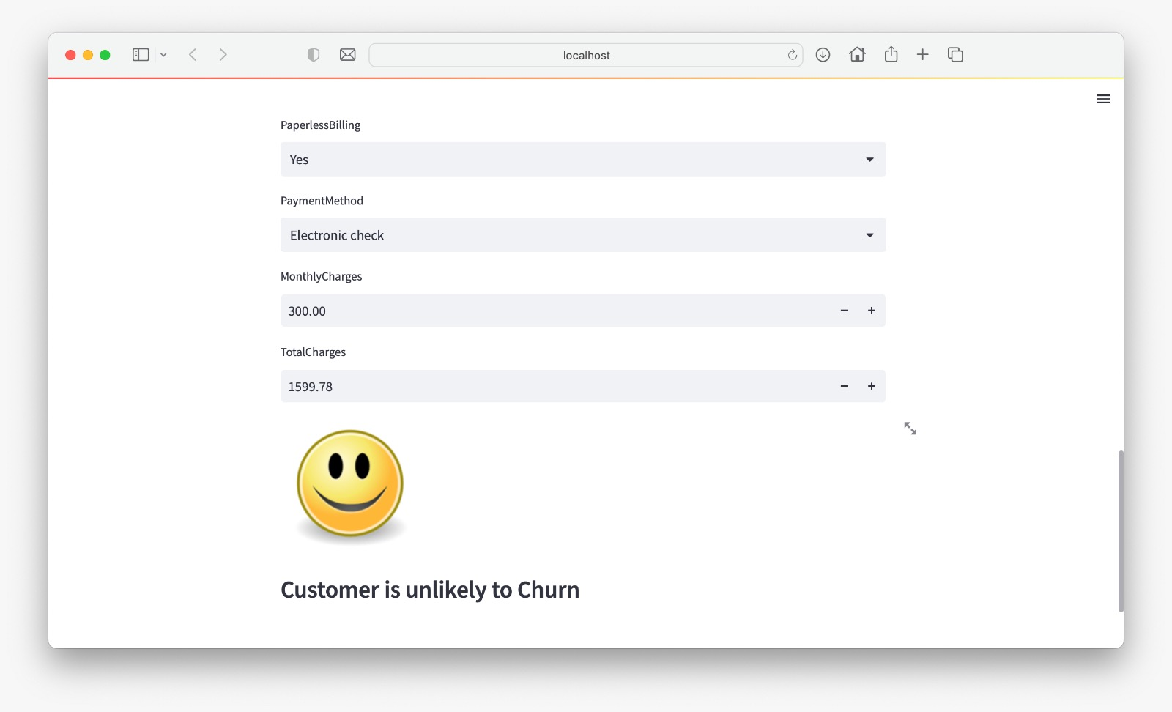
Model Deployment by Streamlit

Slide 13
Challenges:
Uncleaned data
Unnecessary features
Find best model
Adjusting the threshold & Hyperparameter tunning
Creating under and over sampling models through SMOTE
Overfitting issue

Slide 14
Conclusion
we have walked through a complete end-to-end machine learning project using the Teleco customer Churn dataset. We started by cleaning the data and analyzing it with visualization. Then, to be able to build a machine learning model, we transformed the categorical data into numeric variables (feature engineering). After transforming the data, we tried 6 different machine learning algorithms using default parameters. Finally, we tuned the hyperparameters of the Logistic Regression(best performance model) with SMOTE technique for model optimization, obtaining an accuracy of nearly 80%
It is important to stress that the exact steps of a machine learning task vary by project. Although machine learning projects tend to be iterative rather than linear processes, where previous steps are often revisited as we learn more about the problem we try to solve.

Slide 15
Thank You

